Slide 1

Capstone Project Presentation
🏢 Montgomery Alcohol Beverage Services Government Project
Emilio Sanchez San Martin
Data 205 | Spring Semester 2025
Prof. Perine

Slide 2




OVERVIEW / GOAL
OVERALL PROBLEM: Stores in MOCO County have either too much (🥴) or too little (😫) inventory of alcohol.
TOO MUCH = Waste!
TOO LITTLE = Lost sales!
Goal🎯: Making a BETTER inventory algorithm to find JUST the right amount of stock level for each product!
Solution💡: Using weekly 2024 data to explore patterns and build logic from HIGH, MEDIUM, and LOW volume stores!
Ensuring stores for ABS maintain the BEST stock levels

Slide 3


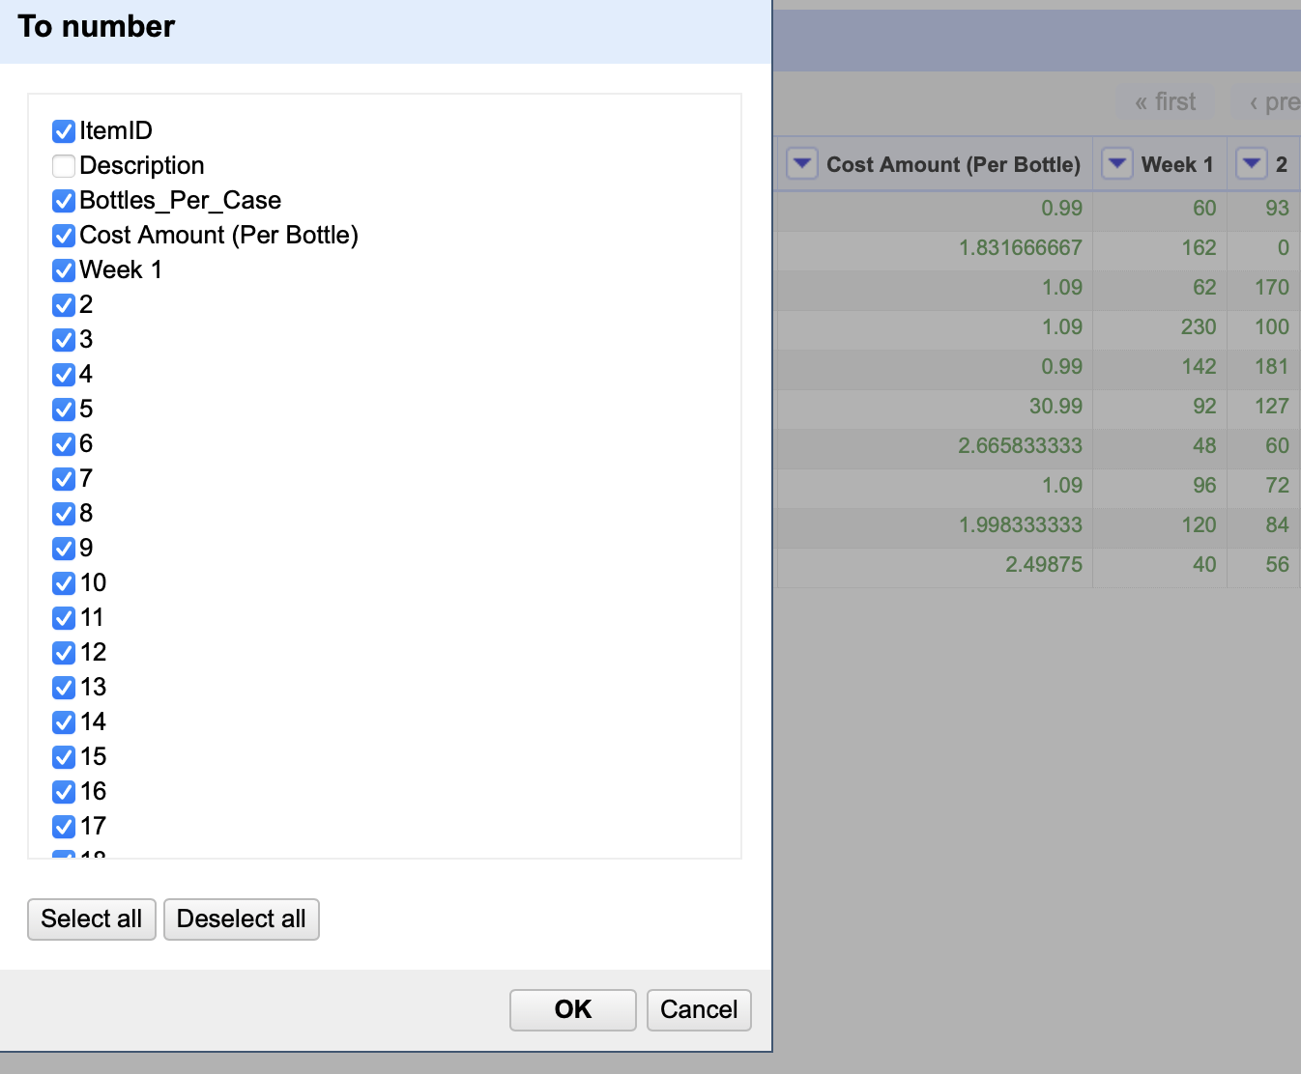
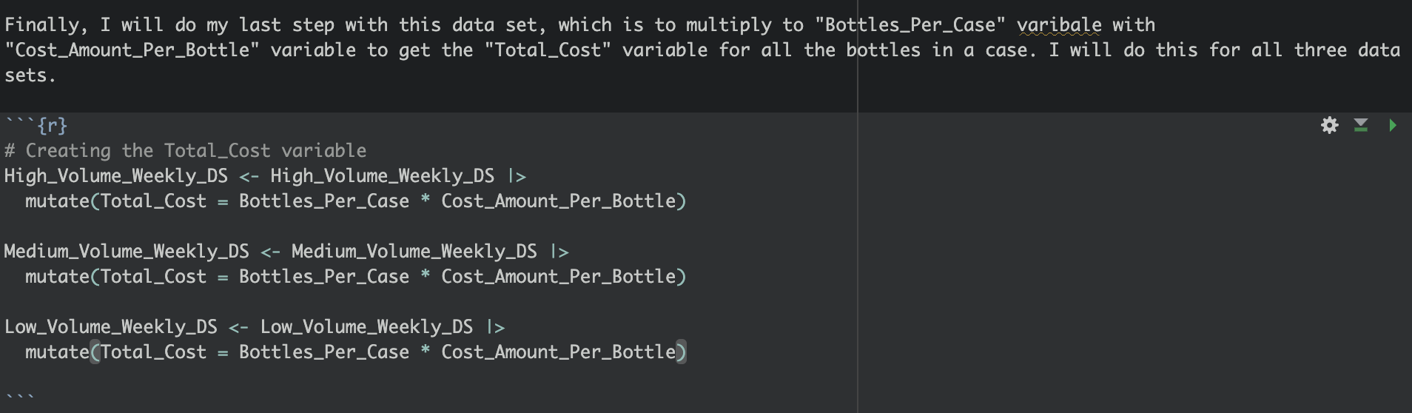
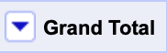
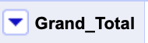
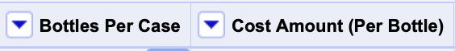

The Data Cleaning Process - FIRST starting off!
📦 Three datasets: High, Medium, & Low Volume Stores
🧹 Data Cleaning:
Sources: OpenRefine RStudio
ItemID | Description (product name)
Bottles Per Case | Cost Amount (Per Bottle)
*Total Cost (NEW) (Calculation of bottles per case * cost amount) | *WEEKS (1-53) Year 2024 Grand Total
Renamed each number of the week to “Week #”
Added “_” for every space in the variable.
No NA’s
Multiplied for Total_Cost (Per case)
500 Rows | 59 columns
Sales Data for each week

Slide 4
Implementing Algorithm!
LIMITATIONS:
📦 EVERY volume store dataset gained additional variables AFTER implementing ABS Algorithm.
🔍 Step 1: Collect Sales Data
Sales for each product are grouped into three 5 week periods (15 weeks total) each store
📦 Step 3: Set Minimum Shelf Stock (MSS)
• If total sales < 1 case ➡️ MSS = 0
• If sales > 1 case:
• Use PD1 or Combined Avg depending on STDev
• Multiply chosen avg by the Reorder Threshold (🍺Beer = 14 days, 🥃Others = 10 days)
📈 Step 2: Calculating Sales Trends
For each item:
• Daily averages (each 5-week period) = calculated
• Combined average = computed 🧮
• Standard deviation (📏 STDev) need to see consistency
Step 4: Calculate Reorder Quantity
• Daily avg × Lead Time (10 days) + MSS = Reorder Qty
• 📦 Reorder Qty is then rounded to full cases
No data on inventory to really measure ABS Stores' capacity.
Some products are stable in sales; others DON’T (the key)
Using weekly data, but daily would be beneficial to see sales (would, however, take forever; that’s why we use weekly!)
Notes:
📊 Master Planning Process (Simplified)
🔍 Step 1: Collect Sales Data
Sales for each product are grouped into three 5-week periods (15 weeks total) for every store.
🧹 Step (just explain): Clean the Data
Items are removed if they are:
❌ Tagged D, HO, AL
❌ Local spirits or non-retail (bags, kegs, etc.)
❌ Sold less than 5 cases
📈 Step 2: Calculate Sales Trends
For each item:
Daily averages from each 5-week period are calculated 📅
A combined average is computed 🧮
Standard deviation (📏 STDev) checks for consistency
📦 Step 3: Set Minimum Shelf Stock (MSS)
If total sales < 1 case ➡️ MSS = 0
If sales > 1 case:
Use PD1 or Combined Avg depending on STDev
Multiply chosen avg by the Reorder Threshold (🍺Beer = 14 days, 🥃Others = 10 days)
📦 Step 4: Calculate Reorder Quantity
Daily avg × Lead Time (10 days) + MSS = Reorder Qty
📦 Reorder Qty is then rounded to full cases
✅ Step final: Final Checks
Blocked items, Last Call items, and New items are adjusted before uploading to the Master Plan system.

Slide 5
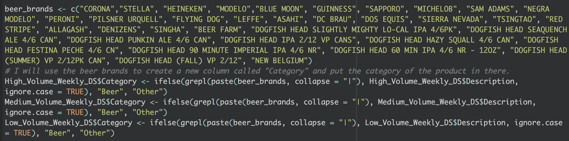
Continue:
Made sure products were categorized by "Beer" for different Reorder Treshold:
• Beer: 14 days 🍻
• Other: 10 days 🥃
This directly impacts MSS and Reorder Qty calculations.
Gotten functions:
🧠 Reorder Quantity Algorithm (Function: calculate_reorder_sliding) = Master Planning Process
🧊 Minimum Shelf Stock (Function: calculate_mss_sliding) = Same for MSS (buffer stock)
📦 Reorder in Cases (Function: convert_reorder_to_cases)
ABS Stores reorders in full cases (not bottles).
Converts bottle reorder quantity to rounded-up case amounts.
ceiling(reorder_qty / Bottles_Per_Case)
500 Rows | columns
NEW VARIABLES
Reorder_Weeks(16-53)
MSS_Weeks(16-53)
Reorder Cases(16-53)
Notes:
🔄 Post-Algorithm Data Breakdown: How My Inventory Metrics Were Recalculated 🚛📦
After building and applying my inventory planning algorithm, I transformed the raw weekly sales data into a dynamic system of sliding windows, allowing me to compute smart, data-responsive reorder quantities, Minimum Shelf Stock (MSS), and reorder case quantities 🧠➡️📈.
1️⃣ Categorizing Products: Beer vs Other 🍺📦
I began by tagging each product into a new "Category" column:
If the product matched known beer brands, it was labeled “Beer” 🍺.
Everything else was labeled “Other” 🏷️.
🟡 Why?
Different categories have different Reorder Threshold Days:
Beer: 14 days 🍻 Other: 10 days 🥃 This directly impacts MSS and Reorder Qty calculations.
3️⃣ 🧠 Reorder Quantity Algorithm (Function: calculate_reorder_sliding)
For each 15-week window, this function:
🔹 Averages sales over 3 periods
🔹 Compares average sales for variability (standard deviation check) 📉
🔹 Calculates:
Daily Average Sales 🕒
MSS = Daily Avg × Reorder Threshold Days 📦
Reorder Qty = (Daily Avg × Lead Time) + MSS 🧮 ✔️ Rounded to 2 decimal points
🟩 Example: If sales are high and stable, reorder values will be strong. If unstable, the algorithm smooths with combined averages ✨
4️⃣ 🧊 Minimum Shelf Stock (Function: calculate_mss_sliding)
This function isolates the MSS component to understand how much buffer stock each product needs based on its category and sales velocity.
📦 Helps prevent:
Stockouts 😖
Over-ordering 🫠
5️⃣ 📦 Reorder in Cases (Function: convert_reorder_to_cases)
Since stores order in full cases, not bottles, this function converts the bottle-level reorder quantity into rounded-up case amounts using:
ceiling(reorder_qty / Bottles_Per_Case)

Slide 6
LET’S BREAK THE ALGORITHM DOWN!
The three datasets for ABS need to fulfill requirements (depending on the unique store)
1. High-volume, small footprint, two deliveries per week
High sales but limited storage space.
Needs more frequent restocking (hence has two deliveries).
May need to keep lower inventory levels but reorder more often to avoid running out.
2. Mid-volume, large footprint, one delivery per week
Decent sales with plenty of storage.
Can hold more backup inventory.
May tolerate slightly larger reorder quantities less frequently.
3. Low-volume, small footprint, one delivery per week
Lower sales and limited space.
Doesn’t need to hold much but can’t store much either.
Reorder quantities should be tight and accurate to avoid overstock
Notes:
LET’S BREAK THE ALGORITHM THROUGH!
Mind you, we know that the three datasets for ABS need to fulfill these requirements depending on the unique store we have.
1. High-volume, small footprint, two deliveries per week
High sales but limited storage space.
Needs more frequent restocking (hence the two deliveries).
May need to keep lower inventory levels but reorder more often to avoid running out.
2. Mid-volume, large footprint, one delivery per week
Decent sales with plenty of storage.
Can hold more backup inventory.
May tolerate slightly larger reorder quantities less frequently.
3. Low-volume, small footprint, one delivery per week
Lower sales and limited space.
Doesn’t need to hold much but can’t store much either.
Reorder quantities should be tight and accurate to avoid overstock

Slide 7
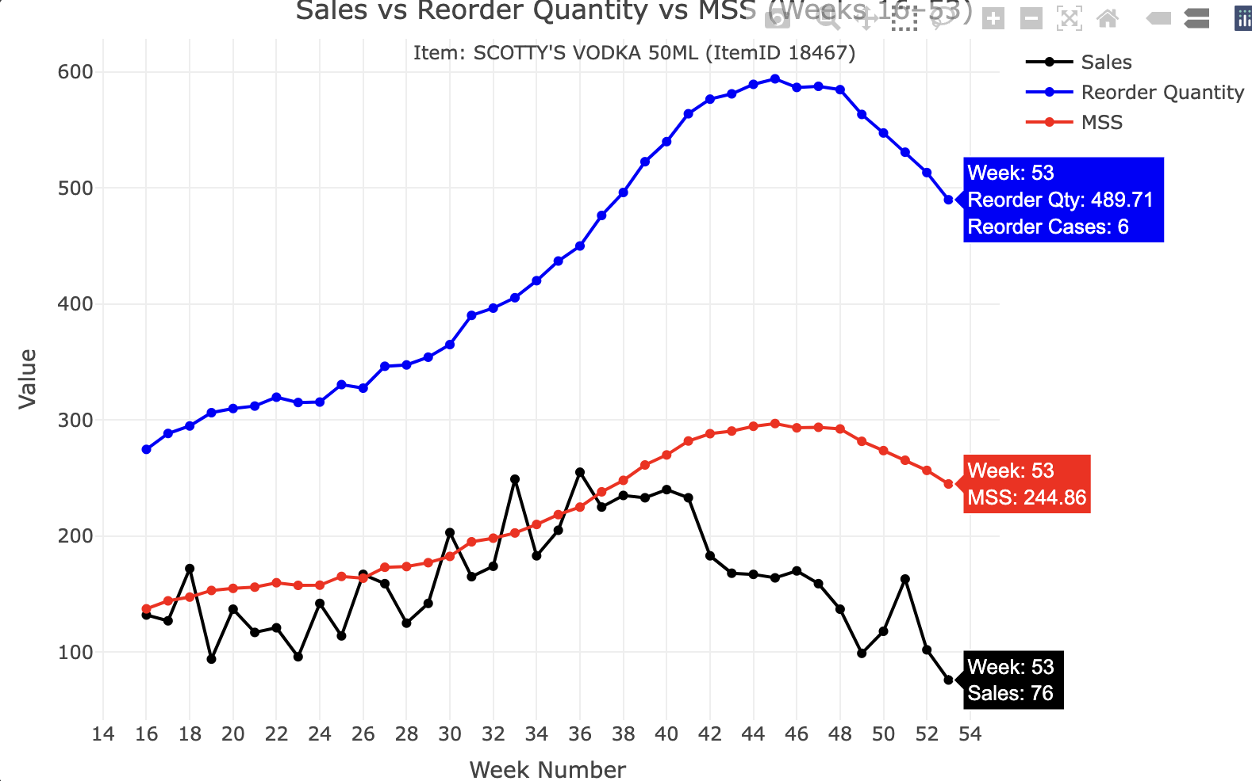
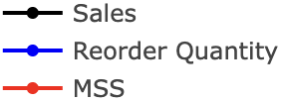
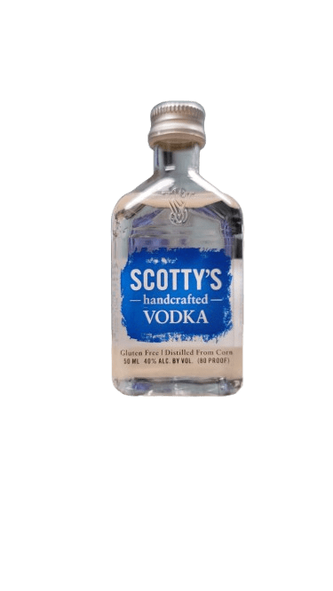
HIGH STORE VOLUME: Results of Algorithm (OVERSTOCK)
Sales vs Reorder Quantity vs MSS (Weeks 16 - 53)
📊 Weeks 16–36 (High Sales Period)
Week 16, 30, 36 SALES > MSS.
(Product moving fast those periods, triggering MSS)
🧪 PRODUCT: SCOTTY’S VODKA 50ML (ItemID: 18467)
BOTTLES PER CASE: 96
RC: 7 = 672 bottles
RC: 6 = 576 bottles
📉 Weeks 42–53 (Sharp Sales Decline)
Sales drop ALOT below MSS.
Week 42 & Week 53: LOW SALES ⚠️
RC: 5 = 480 bottles
RC: 4 = 384 bottles
RC: 3 = 288 Bottles
PROBLEM: The algorithm uses high previous sales, but it declines! (Overstocking)
We need to adapt to sales drops.
Notes:
🧪 PRODUCT: SCOTTY’S VODKA 50ML (ItemID: 18467)
Time Frame: Weeks 16–53
I plotted:
Sales (black line)
MSS (Minimum Shelf Stock) (red line)
Reorder Quantity (blue line, ~2× MSS)
🔍 WHAT THE ALGORITHM IS DOING
The Master Planning Algorithm estimates how much stock a store should always have (MSS) and how much to reorder (Reorder Quantity) based on past sales (especially PD1) and standard deviation (to avoid overreacting to weird spikes or drops).
MSS = expected 10-day demand
Reorder Quantity = MSS + expected 10-day demand (so basically double of MSS for many items)
This is a forecast-based inventory model. It’s assuming that recent high sales trends will continue unless the data shows strong variability (std dev > 3).
📈 SALES PATTERN SUMMARY
You gave critical examples, so let’s summarize my product’s story:
📊 Weeks 16–36 (High Sales Period)
Sales regularly exceed MSS.
Examples:
Week 18: Sales (172) > MSS (147.43)
Week 30: Sales (203) > MSS (182.48)
Week 36: Sales (255) > MSS (224.95)
✅ What this means:
The product is moving fast.
MSS is well-justified.
Reordering logic is working — it’s keeping up with demand.
You’re not risking stockouts — maybe even underestimating demand slightly.
📉 Weeks 42–53 (Sharp Sales Decline)
Sales drop significantly below MSS.
Examples:
Week 42: Sales ~150 vs MSS ~288
Week 53: Sales 76 vs MSS 244.86
⚠️ What this means:
The algorithm is still using high previous sales (like from PD1 or the Combined Average) to calculate MSS.
However, recent sales have sharply declined.
The store is likely overstocked — demand dropped but MSS and reorder quantities remained high.
The algorithm might not be reacting fast enough to recent drops — or PD1 was just so high that it’s still driving the numbers.
🧠 HOW TO THINK ABOUT EACH METRIC
Sales > MSS Inventory is well-used; demand is high. ✅ Sales < MSS (briefly) Could be a short-term dip, maybe okay. Sales < MSS (for many weeks) 🚨 Overstock risk. Demand may be overestimated. Sales ≈ Reorder Qty 🔁 ABS reordering just in time. Possibly good — but risky if there’s a surge. Sales far below both MSS & Reorder Qty ❌ Oversupply. ABS holding too much product. Wasted shelf space, tied-up inventory.
🧩 WHY THIS HAPPENED
The algorithm prioritizes past trends — especially PD1 (recent 5-week period) — but only switches to a combined average if sales variability is high.
In my case:
PD1 was likely very strong (weeks 31–35 or so) — so the MSS stayed high.
Sales crashed starting Week 41, but the algorithm didn’t adjust quickly because:
Standard deviation may not have triggered a switch to a lower average.
There is no “cool down” logic in the base algorithm — it doesn’t account for sudden market changes or seasonality unless you code it in.
💡 HOW TO EXPLAIN THIS CLEARLY (IN SIMPLE TERMS)
“From Weeks 16–36, this product had high sales — often above the target inventory level (MSS), which means our planning was solid. But starting around Week 41, demand dropped significantly while MSS remained high. Since the algorithm relies on past strong sales to calculate inventory needs, it continued suggesting high reorder quantities even though demand had declined. This led to a mismatch between inventory and actual demand, meaning the store may be overstocked in the last part of the year.”

Slide 8
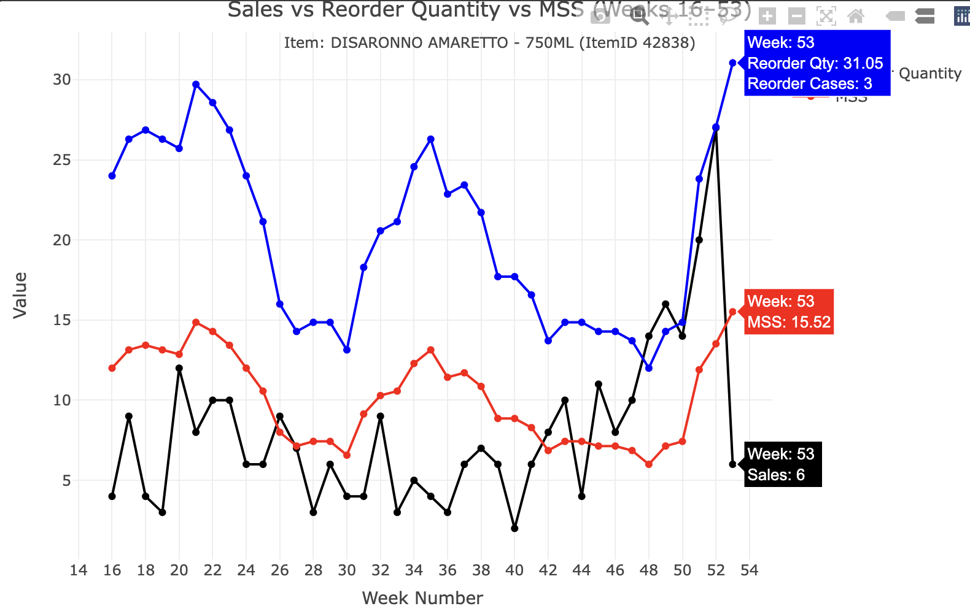
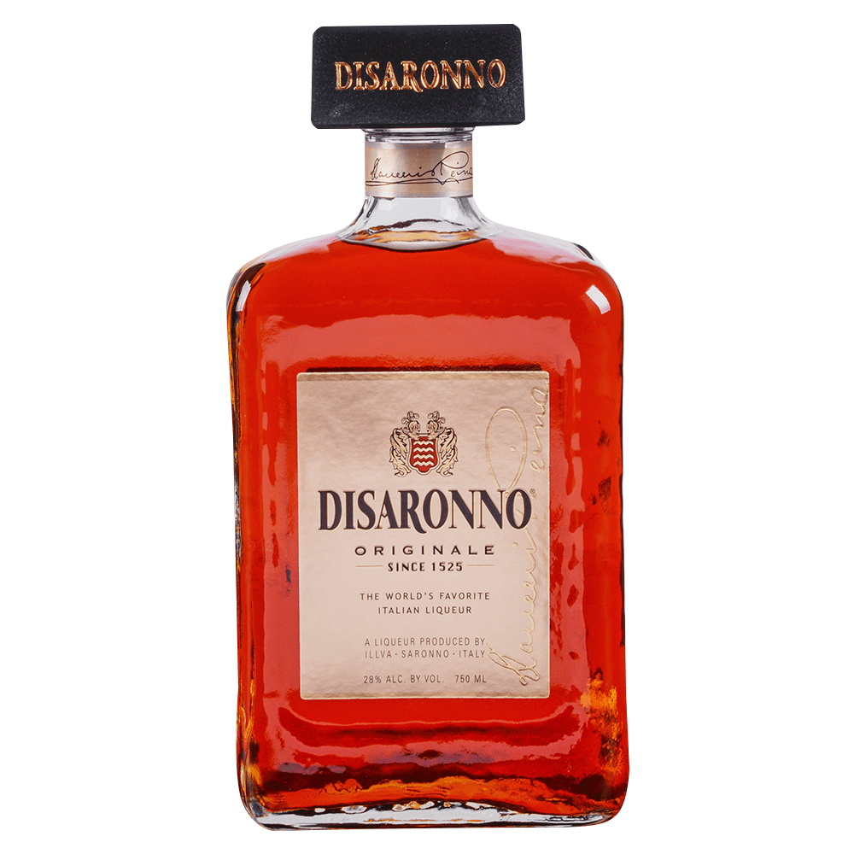
HIGH STORE VOLUME: Results of Algorithm (UNDERSTOCK)
Sales vs Reorder Quantity vs MSS (Weeks 16 - 53)
🧪 PRODUCT: DISARONNO AMARETTO - 750ML (ItemID 42838)
🟠 SALES PATTERN:
- SALES are NOT Stable, Spikes randomly (Sales low/high), algorithm is not adapting to change well
BOTTLES PER CASE: 12
RC: 2 = 24 Bottles
Times Sales lower or higher than MSS = Algorithm slow to respond
Weeks 45 - 52: Sales explode!
Reorder quantity got touched/exceeded‼️
RC: 1 = 12 Bottles
🧠 Store running close to stockouts.
🧠 Algorithm reacts but lags a bit
🧠 Implementing more weight to recent weeks would help!
Notes:
🧠 QUICK REMINDER – What Do These Lines Mean?
Black line = Sales (in bottles) Shows how many bottles were sold each week.
Red line = MSS (Minimum Shelf Stock) This is the minimum number of bottles the store wants to always have on hand. If sales get close to or go over this line, it might be time to reorder soon.
Blue line = Reorder Quantity This is the target inventory level after restocking. It’s twice the MSS (based on the ABS algorithm).
🧾 BASIC ALGORITHM BEHAVIOR (Summary)
For each week:
It looks at recent sales (weighted by period or average).
Based on that, it calculates:
Red line (MSS) = average weekly sales × 10 (the reorder threshold in days)
Blue line (Reorder Qty) = average weekly sales × (10 [MSS] + 10 [Lead Time]) = 20 days worth of stock.
If actual sales (black line) are close to or above the red line, it means inventory is running low, and it’s time to reorder.
📊 WHAT’S HAPPENING WITH DISARONNO AMARETTO - 750ML?
🟠 GENERAL SALES PATTERN:
Sales are up and down, not totally stable.
Sales start low (Week 16: 4 bottles = ~1 case), then:
Spike randomly (e.g., Weeks 20, 21, 27)
Dip sharply (Weeks 32–38: sales are very low)
Climb strongly from Week 45 to 52 (up to 27 bottles in Week 52 — more than 2 full cases)
🔍 HOW TO INTERPRET THE BEHAVIOR:
🧵 Weeks 16–21
📉 Sales are sometimes below the MSS (red line), meaning inventory probably remained stable.
The algorithm doesn’t change MSS much here — it’s around 12–15, assuming recent sales stay modest.
🧠 Interpretation: Demand is low to medium. No urgent changes needed yet.
📉 Weeks 32–38: Drop in Sales
Sales stay well below MSS (sales as low as 2–4 bottles while MSS is still ~7–9). 🔻 This is an example where the algorithm is slow to respond.
MSS (red line) lags behind and doesn’t drop fast enough.
Result: You’re holding more inventory than needed.
🧠 Explanation: The algorithm uses older sales in its averages (like 5-week blocks), so it takes a while to recognize a drop in demand.
📘 This is a good time to suggest weighted averages or demand decay to speed up reaction.
🚀 Weeks 45–52: Sales Explode
Weekly sales go above the red line almost every week.
MSS is too low, and even the reorder quantity (blue line) gets touched or exceeded.
Week 52: Sales = 27 bottles (over 2 cases). MSS = ~15.4. Reorder Quantity = ~30.8
🧠 Interpretation: The store is likely running close to stockouts.
Algorithm reacts, but still lags a bit (due to how it averages data).
🧠 This is another case where rolling averages or giving more weight to recent weeks would help.
✅ WHAT THIS ALL MEANS IN SIMPLE TERMS:
“DISARONNO sales start slow, then fluctuate. Around mid-year, sales dip hard, but the algorithm doesn’t react fast enough — we keep too much stock. Later in the year, demand shoots up fast. The algorithm starts raising the reorder amounts and MSS, but it’s still a bit slow, so sales go over those thresholds. This means we risk running out. The algorithm works okay, but it reacts slowly to change — it needs better sensitivity to recent trends.”
🧠 BONUS – HOW TO EXPLAIN THIS TO SOMEONE ELSE
You might say something like:
“The black line shows how many bottles we sold each week. The red line is the minimum we want to have in the store, and the blue line is how much we aim to restock to.
Early in the year, sales were low, and the system kept the red and blue lines fairly stable. When sales dipped even lower, the algorithm was a little slow to lower stock levels — so we probably held too much.
But later in the year, when sales spiked hard, we were often selling more than our target inventory levels. That means the algorithm wasn’t fast enough to increase reorder quantities, which could lead to stockouts.
So this shows we might want to change the algorithm to be more responsive — maybe by using rolling averages or giving more weight to the most recent weeks.”

Slide 9
POSSIBLE SOLUTION! 💡
🔁 PROBLEM RECAP:
• 📉 Sales drop fast (weeks 42–53) | MSS and reorder quantities stay high.
• 📈 Sales spike in certain weeks (weeks 42 - 52) | System doesn’t respond fast enough.
✅ GOAL: Making the algorithm adapt quickly to changing sales trends!
MSS and Sales closely align, but
• MSS should be slightly above Sales (safety buffer).
• MSS should not lag behind if Sales are increasing quickly.
• MSS should drop fast when Sales go down (to prevent overstocking).
FIRST IDEA: Weight Averages! Giving MORE IMPORTANCE to Recent Trends
🔧 HOW TO IMPROVE THE ALGORITHM:
🧠 Logic: Weighting periods 3 (more recent), 2 a bit less, and 1 the least.
Something like:
weighted_avg <- (avg1 * 0.2 + avg2 * 0.3 + avg3 * 0.5)
SECOND IDEA: Coefficient Variation! This is a statistical measure to track variability for products sold throughout the week. CV = Standard Deviation of PD1, PD2, PD3/Mean of PD1, PD2, PD3
If CV > 0.3 (or another threshold), switch to shorter periods.
Notes:
🔁 PROBLEM RECAP:
You noticed the current algorithm is a bit slow to react when sales suddenly drop or increase. For example:
📉 Sales drop fast (weeks 42–53), but MSS and reorder quantities stay high.
📈 Sales spike in certain weeks, and sometimes the system doesn’t respond fast enough.
✅ GOAL:
Make the algorithm adapt more quickly to changing sales trends. You want the MSS (red line) and Sales (black line) to stay closely aligned, but:
MSS should be slightly above Sales (to act as a safety buffer).
MSS should not lag behind if Sales are increasing quickly.
MSS should drop fast when Sales go down (to prevent overstocking).
🔧 HOW TO IMPROVE THE ALGORITHM
🔁 1. WHY I may use a Weighted Average?
my current algorithm treats each 5-week period equally. That’s simple and fair, but not responsive to recent demand. A weighted average solves this:
✅ Purpose:
It gives more importance to recent trends, which is key for products like DISARONNO AMARETTO - 750ML, where demand changed significantly from week 45 onward.
🧠 Example Logic:
Weight period3 (weeks 11–15) the most because it’s the most recent.
Weight period2 a bit less, and period1 the least.
🔢 Suggested Weights:
weighted_avg <- (avg1 * 0.2 + avg2 * 0.3 + avg3 * 0.5)
🧠
WHY USE CV (Coefficient of Variation)?
The Coefficient of Variation (CV) is a statistical measure of relative variability, calculated as: CV = Standard Deviation / Mean It tells us how volatile or unstable the sales data is relative to the average. A high CV means the sales trend is very inconsistent, while a low CV means sales are stable.
✅
HOW CV IS USED IN YOUR ALGORITHM
You use CV as a trigger to detect sales instability over the past 15 weeks. Here’s how:
Split the last 15 weeks into 3 sub-periods: default is 5-5-5.
Calculate average sales in each period: avg1, avg2, avg3.
Calculate CV across those 3 averages.
If CV > 0.25 or you detect a trend reversal (like up–down or down–up), you say:
“Whoa, things are unstable!”
So you redefine the periods to a more recent-focused 5-4-3 structure.
Then you apply more weight to recent sales, using a weighted average:
avg1 * 0.2 + avg2 * 0.3 + avg3 * 0.5
In your original ABS algoirhtm, you guys take the standard deviation defines as the different of the first average subtracted by thre conbined average, and looking if it is over 3.
abs(avg1 - combined_avg) > 3
To make our inventory algorithm more adaptive, we introduced the Coefficient of Variation (CV) to measure sales volatility. If CV is high or if trends reverse direction, our model flags the period as unstable. In those cases, we shift from a balanced 5-5-5 week split to a more recent-focused 5-4-3 split, and we apply heavier weighting to the most recent sales. This allows the algorithm to respond faster to sudden demand changes, preventing both overstock and stockouts. The result is a smarter, more agile approach to inventory management.
Why is CV relevant in the context of my algorithm?
In your inventory optimization scenario (with MSS, Reorder Quantity, and sales), the CV can help me determine how unstable or volatile the sales data is. When sales data is highly variable (lots of ups and downs), it becomes harder to predict future sales, and consequently harder to determine the correct MSS (Minimum Shelf Stock) or reorder quantities.
The logic you’re using with CV in your new algorithm might work like this:
CV > 0.25: If the coefficient of variation is greater than 0.25, it indicates that the sales data is more volatile than usual. You would flag this as unstable and adjust the calculation of MSS or reorder quantities, as unstable sales trends make predictions harder.
Sales trend reversals: If the average sales in the first period are different from the second and third periods (like an upward trend in one and a downward in another), it’s also flagged as unstable. This type of volatility means using simple averages (as in the original MSS algorithm) may not be accurate enough.

Slide 10
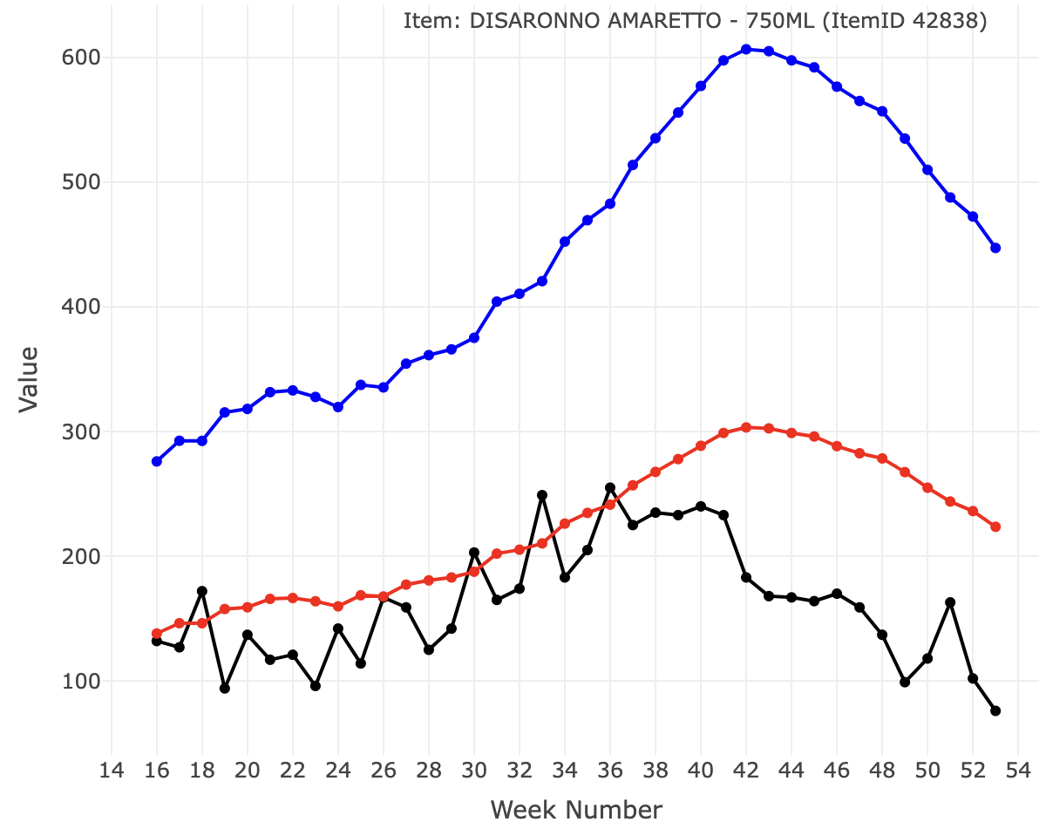
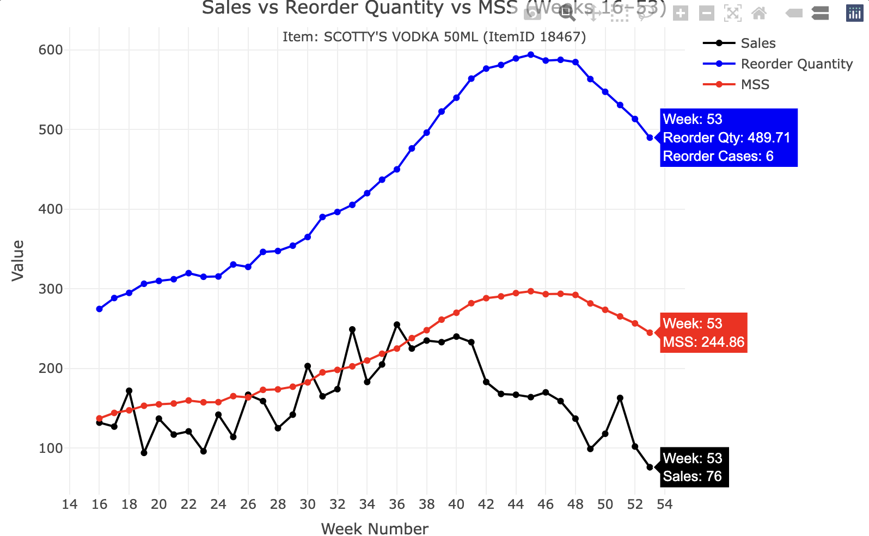
Implementing FIRST IDEA ONLY
RC: 6 = 576 bottles
RC: 5 = 480 bottles
RC: 4 = 384 bottles
RC: 3 = 288 Bottles
RC: 2 = 192 Bottles
Small difference
MSS typically goes HIGHER When needed, which is good to capture higher reorder quantity. But…
It does not take MSS down when needed (Needs to track instability)
Notes:
METRICES:
Stockout Risk - ABS Algorithm: 13.16 %
Stockout Risk - Weighted Algorithm: 10.53 % (sales pass MSS red line)
Avg Excess Stock - ABS Algorithm: 60.45 (better
Avg Excess Stock - Weighted Algorithm: 63.08
Reorder Qty Volatility - ABS Algorithm: 111.13
Reorder Qty Volatility - Weighted Algorithm: 109.06
Fit Breakdown - ABS Algorithm:
Good Fit Too High Too Low
5.3 65.8 28.9
Fit Breakdown - Weighted Algorithm:
Good Fit Too High Too Low
10.5 84.2 5.3

Slide 11
My Algorithm VS ABS
🔄 Enhancing ABS’s Reorder Algorithm: Smarter, More Adaptive Predictions
✅ Key Improvements
📊 Adaptive Periods:
Original: Fixed 5-5-5 week splits
Mine: Adjusts to 5-4-3 if sales are volatile (using coefficient of variation or trend reversals) → Responds better to shifting demand patterns
⚖️ Weighted Averages:
Original: Simple average or avg1
Mine: Weighted (20%-30%-50%) toward recent sales → Captures trends without overreacting to short-term noise
📉 Instability Detection:
Mine flags unstable patterns (up-down-up) → Improves predictions for erratic or seasonal items
📦 Reorder Logic:
Same base formula, but my algorithm gives smarter averages → More accurate MSS and reorder quantities → Reduces overstock + stockouts
unstable <- (cv > 0.25) || ((avg1 < avg2 & avg2 > avg3) | (avg1 > avg2 & avg2 < avg3))
Notes:
Here’s a professional and clear explanation you can use to present your algorithm improvements to the ABS team, highlighting what you changed, why you changed it, and how it improves reorder prediction and MSS accuracy:
📈 Enhancing ABS’s Reorder Quantity Algorithm: Key Improvements and Rationale
In developing a customized reorder quantity algorithm for ABS, I used the original 15-week sliding window approach as a baseline. From there, I introduced several enhancements to improve the algorithm’s ability to capture real sales dynamics, handle unstable or shifting trends, and generate more responsive Minimum Shelf Stock (MSS) and reorder quantities. Below are the key differences and justifications for each change:
🔍 1.
Dynamic Handling of Sales Instability
Original:
Always splits the 15-week window into three fixed 5-week periods (5-5-5).
Detects instability using a basic comparison between avg1 and the combined average.
Improved:
Uses Coefficient of Variation (CV) to measure sales volatility.
Detects reversal patterns like peaks or dips (e.g., up-down-up). || ((avg1 < avg2 & avg2 > avg3) | (avg1 > avg2 & avg2 < avg3)) (MORE DETAIL: This is part of your instability detection logic.
It checks for trend reversals — basically looking for a “peak” or “valley” pattern across your 3 periods (p1, p2, p3): avg1 < avg2 & avg2 > avg3 → Sales peak in the middle (like a spike) avg1 > avg2 & avg2 < avg3 → Sales dip in the middle (like a slump) (The extra trend check)
Logical back up ot catch unusual patterns like spikes or drops that trigger the CV; just an idea to add a layer of detection that could possibly work.
If instability is detected, it switches to adaptive period lengths (5-4-3) to give more weight to the most recent sales while still capturing trends.
Why it matters:
Retail sales are not always stable. This adaptive approach prevents the algorithm from over-relying on older, potentially irrelevant data and gives it a smarter way to respond to sudden changes (e.g., product going out of season, being promoted, or understocked).
⚖️ 2.
Weighted Average for Trend Responsiveness
Original:
Uses a simple average or chooses between avg1 and combined average based on standard deviation.
Improved:
Calculates a weighted average of period averages:
20% weight on the oldest period (p1)
30% on the middle (p2)
50% on the most recent (p3)
Why it matters:
Recent demand is typically more predictive of near-future demand. The weighted trend line helps anticipate increasing or decreasing demand more effectively, which is critical for minimizing both stockouts and overstock.
🧠 3.
Smarter Threshold for Reordering
Both algorithms:
Avoid reordering if total sales over 15 weeks are less than one case.
Improved clarity:
The updated version applies this threshold after evaluating the adaptive sales window, ensuring it’s only skipped if recent demand has truly dropped.
📦 4.
Refined Reorder Quantity & MSS Calculation
Original:
Uses daily average based on a possibly outdated average (e.g., avg1).
Reorder quantity = (daily avg × lead time) + MSS, where MSS = daily avg × days of buffer stock.
Improved:
Daily average is calculated from a weighted or adaptive average, improving responsiveness to real-time shifts.
Maintains the same logic for MSS and reorder quantity but ensures the input values are more accurate and reflective of recent trends.
✅ Summary of Benefits
These changes make the algorithm more resilient to volatility, better aligned with operational realities, and more accurate in predicting actual demand, especially for products with inconsistent or seasonal sales. The goal is to ensure stores don’t overstock slow movers or run out of fast movers, especially in high-demand categories like Beer and Spirits.

Slide 12
Explanation of metrics
🔍 Metric Breakdown – Quick Definitions
📉 Stockout Risk % of weeks where sales exceeded MSS → risk of running out (When MSS Red line is over Black Sales line) → Lower = better product availability
📦 Avg Excess Stock Avg # of units above what was actually sold → Lower = better shelf space use & cost efficiency
🔄 Reorder Volatility Measures how much reorder quantities change week to week → Lower = smoother operations, easier planning
⚖️ MSS Fit Breakdown
Good Fit: MSS ≈ Sales → balanced inventory
Too Low: MSS < Sales → understock risk
Too High: MSS > Sales → overstock waste → Aim for more Good Fit weeks
Notes:
⚠️ Stockout Risk
What it means: The percentage of weeks where sales exceeded the Minimum Shelf Stock (MSS), indicating a risk of running out of stock.
What to say: “Stockout Risk tells us how often we might not have enough product on the shelf to meet demand. A higher number here means more chances of losing sales — so keeping this low is crucial, especially for high-demand items.”
📦 Average Excess Stock
What it means: The average amount of product sitting on shelves beyond what was needed — a sign of overstocking.
What to say: “This metric shows how much extra inventory we’re holding each week. Lower values mean we’re using shelf space more efficiently and reducing costs from holding unsold product.”
🔄 Reorder Volatility
What it means: Measures how much reorder quantities fluctuate from week to week. High volatility = inconsistent ordering.
What to say: “Reorder Volatility tells us how stable our ordering pattern is. Less fluctuation is better — it makes inventory planning easier and reduces stress on store operations.”
⚖️ MSS Fit Categories
What it means: A breakdown of how well MSS aligns with actual sales each week.
Good Fit = MSS is close to actual sales (within ±15%)
Too Low = MSS is too low (risking stockouts)
Too High = MSS is too high (wasting shelf space)
What to say: “This is about balance. We want MSS to match real sales as closely as possible. A ‘Good Fit’ means we hit that sweet spot — enough inventory to meet demand, but not too much. Too High means we’re overstocking; Too Low means we risk selling out.”
📊 McNemar’s Test
What it means: A statistical test used to compare the significance of the difference between two algorithms on stockout flags (paired data).
What to say: “This test checks if the difference in stockout results between the two algorithms is statistically meaningful. In this case, the p-value was high, so we can’t say with confidence that one is significantly better — though there are still practical differences worth considering.”

Slide 13
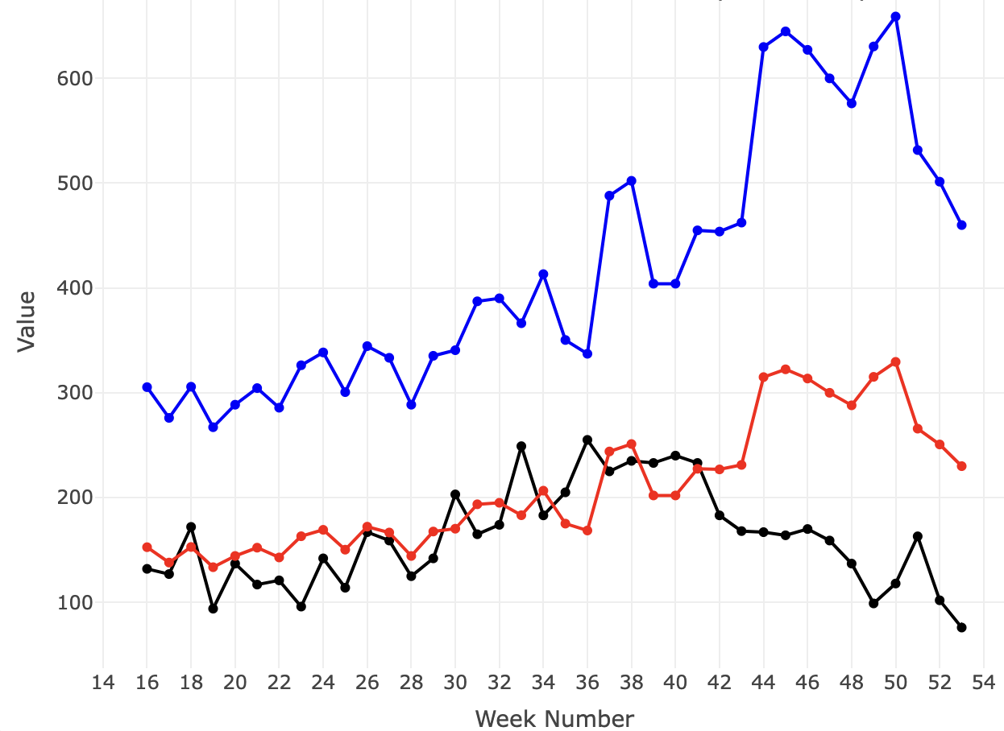
Sales vs Reorder Quantity vs MSS (Weeks 16 - 53)
BOTTLES PER CASE: 96
🧪 PRODUCT: SCOTTY’S VODKA 50ML (ItemID: 18467)
RC: 6 = 576 bottles
RC: 5 = 480 bottles
RC: 4 = 384 bottles
RC: 3 = 288 Bottles
MSS caught more better with Reorder qty at beginning. Went down hill here.
METRICS:
⚠️ Stockout Risk
Mine: 21.1% | ABS: 13.2%
My model is more prone to understocking, increasing the risk of stockouts.
📦 Avg Excess Stock
Mine: 55.6 | ABS: 60.5
My algorithm is slightly more efficient with shelf space and storage.
⚖️ Balance (MSS Fit)
- ✅ Good Fit: 18.4% (tie for both)
- 📈 Too High: 63.2% (Mine) vs. 71.1% (ABS)
→ My algorithm slightly reduces overstocking.
- 🛑 Too Low: 18.4% (Mine) vs. 10.5% (ABS)
→ ABS has better protection against demand spikes.
🔄 Reorder Volatility
Mine: 120.9 | ABS: 111.1
My reorder amounts are more erratic, which may cause planning issues for future algorithms
Notes:
✅ My Strengths
💰 Less excess inventory → saves space and money
↘ Slightly lower overstocking rates than ABS
🎯 Tied in achieving “Good Fit” weeks
⚠️ My Weaknesses
❌ Higher stockout risk (21% vs. 13%) is a concern — especially for popular items
📉 More variation in weekly reorder quantity → might frustrate staff/logistics
🛑 More “Too Low” weeks = higher chance of not meeting sudden demand
METRICES
Scottys Vodka:
| **Metric** | **My Algorithm** | **ABS Algorithm** | **Interpretation** |
|------------------|------------------|------------------|------------------|
| **Stockout Risk** | 21.05% | **13.16%** | My algorithm is **more prone to u n derstocking**, which can lead to stockouts |
| **Avg Excess Stock** | **55.62** | 60.45 | I am slightly **more efficient**, with less excess inventory |
| **Reorder Volatility** | 120.94 | **111.13** | My reorder amounts are a bit **more erratic** than ABS’s |
| **Balance Score** | 18.4% Good Fit | 18.4% Good Fit | Tie — both hit the same % of weeks where MSS matched demand well |
| | 18.4% Too Low | **10.5% Too Low** | ABS is **less likely** to understock (better safety margin) |
| | **63.2% Too High** | 71.1% Too High | My model **overstocks slightly less** than ABS |
What This Suggests:
Strengths (My algorithm) • hold less excess inventory, which is good for
saving space and money. • slightly reduce overstocking compared to ABS.
• achieve the same % of Good Fits as ABS.
Weaknesses of my Algorithm • Higher stockout risk (21% vs. 13%) is a
major concern — especially for high-demand items. • More week-to-week
variability in reorder quantity might frustrate managers or disrupt
logistics. • More “Too Low” weeks than ABS — meaning you’re sometimes
not covering demand spikes.
What McNemar’s Test Tells Us
The McNemar test (p = 0.37) shows that the difference in stockout risks
between the algorithms isn’t statistically significant — at least not
with my my data sample. But the practical impact of stockouts might
still be important, depending on the product type.

Slide 14
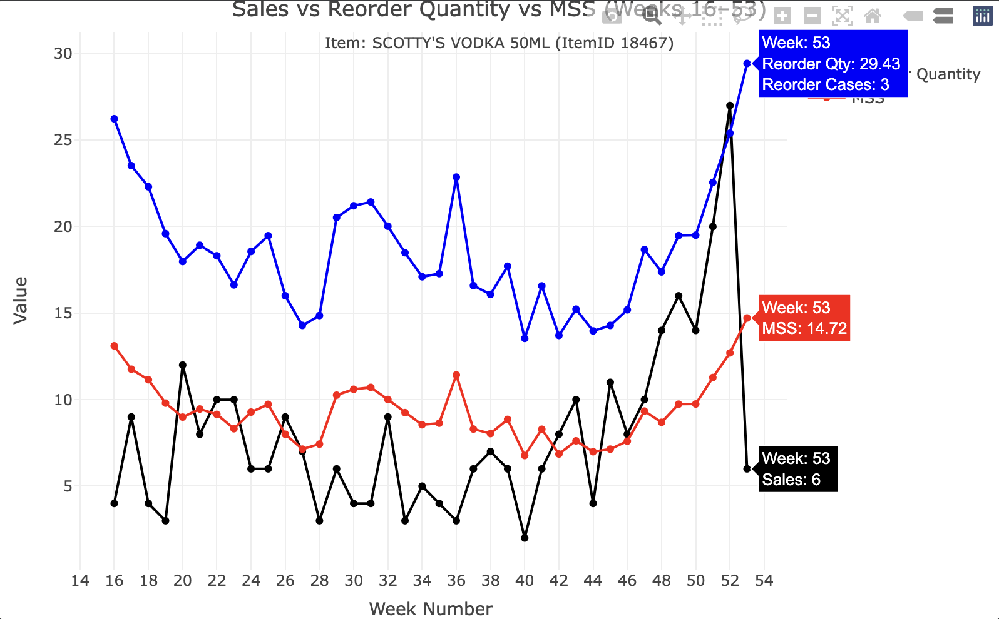
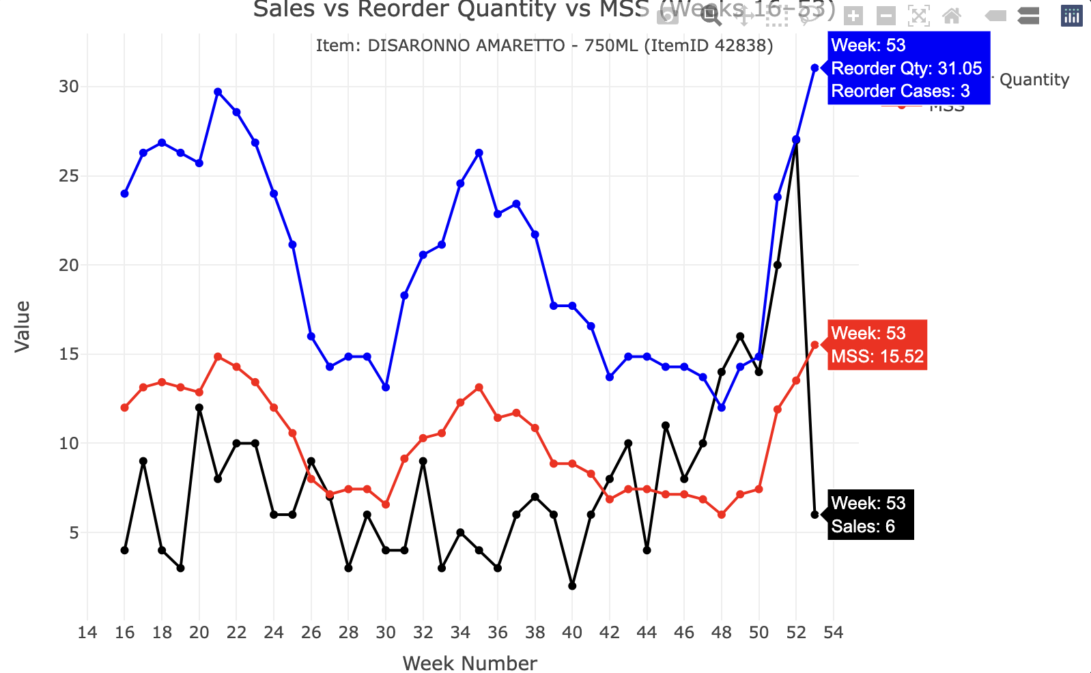
Sales vs Reorder Quantity vs MSS (Weeks 16 - 53)
🧪 PRODUCT: DISARONNO AMARETTO - 750ML (ItemID 42838)
BOTTLES PER CASE: 12
RC: 2 = 24 Bottles
RC: 1 = 12 Bottles
MSS Increased (good) but not ENOUGH to get more cases!
METRICS:
⚠️ Stockout Risk
Mine: 36.8% | ABS: 28.9%
My algorithm is more aggressive, increasing the risk of running out.
📦 Avg Excess Stock
Mine: 2.77 | ABS: 3.68
I hold less unnecessary inventory, which is efficient.
🔄 Reorder Volatility
Mine: 3.65 | ABS: 5.62
My orders are more stable, reducing operational disruptions.
⚖️ MSS Fit Breakdown
✅ Good Fit: 10.5% (Mine) vs. 5.3% (ABS)
→ I slightly outperform ABS on matching MSS to sales.
📈 Too High: 60.5% (Mine) vs. 65.8% (ABS)
→ I’m slightly better at avoiding overstocking.
🛑 Too Low: 28.9% (both)
→ Same understock risk for both algorithms.
Notes:
🧠 Interpretation & Takeaways
• ✅ I reduce overstocking better — less shelf waste, more lean.
• ⚠️ But I pay the price in higher stockout risk — 36.8% is high and risky.
• 🔄 Stability win — reorder amounts are smoother and more predictable.
• ⚖️ Both algorithms still need improvement — mine shows promise but may need more conservative tuning for safety stock.
Metrics:
Disaronno Amaretto:
| **Metric** | **My Algorithm** | **ABS Algorithm** | **Interpretation** |
|------------------|------------------|------------------|------------------|
| **Stockout Risk** | 36.84% | 28.95% | My algorithm is more aggressive, leading to higher risk of stockouts. |
| **Avg Excess Stock** | 2.77 | 3.68 | I am holding less unnecessary inventory — more efficient shelf usage. |
| **Reorder Volatility** | 3.65 | 5.62 | My orders are **more stable**, easier for store staff to manage. |
| **MSS Fit – Good Fit %** | 10.5% | 5.3% | I have a **slightly better balance**, but both struggle to match MSS to sales closely. |
| **MSS Too High %** | 60.5% | 65.8% | I am overstocking **slightly less** than ABS. |
| **MSS Too Low %** | 28.9% | 28.9% | Equal understock risk — which aligns with the identical “Too Low” fit breakdown. |
Interpretation & Takeaways
1\. My algorithm reduces overstocking more effectively, as seen in both
lower Excess Stock and fewer Too High MSS weeks.
2\. However, the cost of that efficiency is higher stock out risk — my
algorithm crosses the 35% mark, which is pretty high. It might be too
aggressive in cutting safety stock for this product.
3\. Stability is a win — My Reorder Volatility is much lower, which
helps operational consistency.
4\. Neither algorithm fits perfectly, but Mys edges out in the “Good
Fit” category. That said, both still leave room for improvement in MSS
tuning for this product.

Slide 15
Conclusion/Experience
I started off with a simple question:
Can we build a smarter inventory algorithm to help ABS stores avoid overstock and stockouts?
This project explored two algorithms — the ABS baseline and my customized model — to optimize Minimum Shelf Stock (MSS) and Reorder Quantities for alcohol inventory across different store types.
Insights:
•📉 Stockout Risk: Both algorithms agreed most of the time, with few minor differences on reorder quantities to catch up with sales based on two different types of products.
•📦 Excess Inventory: At some points, there was just enough inventory. But in
•⚖️ MSS Fit: Continued to keep inventory close to sales
•🔁 Reorder Stability: Weighted averages helped smooth out overreactions and cut down on inconsistent ordering.
While neither algorithm is perfect, my version may offer a customizable alternative that can be fine-tuned by product type or store profile, because it can definitely be considered when looking at oversold products, as we've seen with Disaronno Amaretto.
Next steps could include testing different thresholds, adding external factors like promotions, and automating MSS updates for responsiveness based on several years of data.
Notes:
🎯 Final Thoughts & Key Takeaways
📌 What I Set Out to Do
I started with a simple but important question:
Can we build a smarter inventory algorithm to help ABS stores avoid overstock and stockouts?
With 2024 weekly sales data, I explored trends, tested logic, and customized an adaptive solution across stores with different sales volumes and delivery constraints.
🛠 What I Built
✅ Implemented ABS’s current planning process (MSS + Reorder Quantity)
✅ Created an enhanced algorithm with weighted averages and volatility detection
✅ Added adaptive logic to respond faster to demand shifts
✅ Built visual tools to compare performance over time
✅ Tested using real metrics: stockout risk, excess stock, reorder volatility, and MSS fit
📊 Key Insights
📉 Stockout Risk: Both algorithms agreed most of the time, but mine reacted better to sales spikes and slowdowns in certain products.
📦 Excess Inventory: My version reduced unnecessary stock by tightening over-predictions after demand dropped.
⚖️ MSS Fit: A better balance — keeping inventory close to sales without too much waste.
🔁 Reorder Stability: Weighted averages helped smooth out overreactions and cut down on inconsistent ordering.
💡 What I Learned
A “one-size-fits-all” inventory approach doesn’t work — context matters (store volume, space, delivery).
📈 Data alone isn’t enough — it’s about the logic you apply to it.
🧠 Simple changes (like weighting or CV) can make a big difference in responsiveness.
📊 Statistical tests (like McNemar’s) help validate changes — even when improvement isn’t statistically significant, it can still be operationally valuable.
🌟 Overall Experience
Working on this project helped me:
Sharpen my skills in data analysis, algorithm design, and statistical testing
Think critically about real-world systems (not just code, but how stores operate!)
Understand that optimization is about trade-offs — balancing supply, space, and demand
🚀 What’s Next?
Add daily-level data for more precision
Incorporate seasonal trends or holiday effects
Explore machine learning models to predict spikes
Package the algorithm into a tool ABS staff could use directly!
Project Conclusion
This project explored two algorithms — the ABS baseline and my customized model — to optimize Minimum Shelf Stock (MSS) and Reorder Quantities for alcohol inventory across different store types.
I focused on balancing stock availability vs. inventory efficiency, using real 2024 sales data and evaluating weekly performance.
My algorithm aimed to reduce overstocking and excess inventory, and it succeeded in doing so across products like Scotty’s Vodka and Disaronno Amaretto. But it did at times have it's points of over stocking, when we reach certain weeks as we discussed above.
However, this came at the cost of higher stockout risk, especially for fast-moving products — highlighting the tradeoff between aggressiveness and safety stock.
Key metrics like Excess Stock, Reorder Volatility, Fit Quality, and McNemar’s Test were used to compare both models fairly.
While neither algorithm is perfect, my version offers an efficient, customizable alternative that can be fine-tuned by product type or store profile, because it can definitely be considered when looking at over sold products as we seen with Disaronno Amaretto.
Next Steps could include testing hybrid thresholds, adding external factors like promotions, and automating MSS updates for real-time responsiveness.

Slide 16
References & Acknowledgements
Montgomery College Data Professors
Rachel Saidi – For introducing me to visualizations and laying a strong foundation from the beginning
Mais Mouaffak Alraee - For helping me learn the basics on programming with RStudio from the beginning
Lori Perine – For her continued guidance, support, and feedback throughout this project.
Mentors at Montgomery College & Montgomery County Alcohol and Beverage Services (ABS)
Victoria Liu
Kori Wenman
Le Guellec
Naveen Gattoju Thank you for your time, insights, and guidance during this project. Your perspectives and feedback on the planning for our algorithm and data access were critical to the success of this project.
Peer Support
Emilio Difilippantonio – A fellow student working on a similar project with ABS. His ideas, feedback, and collaboration were valuable— thank you for being a great partner and creative thinker throughout this journey.
Notes:
🎯 Final Thoughts & Key Takeaways
📌 What I Set Out to Do
I started with a simple but important question:
Can we build a smarter inventory algorithm to help ABS stores avoid overstock and stockouts?
With 2024 weekly sales data, I explored trends, tested logic, and customized an adaptive solution across stores with different sales volumes and delivery constraints.
🛠 What I Built
✅ Implemented ABS’s current planning process (MSS + Reorder Quantity)
✅ Created an enhanced algorithm with weighted averages and volatility detection
✅ Added adaptive logic to respond faster to demand shifts
✅ Built visual tools to compare performance over time
✅ Tested using real metrics: stockout risk, excess stock, reorder volatility, and MSS fit
📊 Key Insights
📉 Stockout Risk: Both algorithms agreed most of the time, but mine reacted better to sales spikes and slowdowns in certain products.
📦 Excess Inventory: My version reduced unnecessary stock by tightening over-predictions after demand dropped.
⚖️ MSS Fit: A better balance — keeping inventory close to sales without too much waste.
🔁 Reorder Stability: Weighted averages helped smooth out overreactions and cut down on inconsistent ordering.
💡 What I Learned
A “one-size-fits-all” inventory approach doesn’t work — context matters (store volume, space, delivery).
📈 Data alone isn’t enough — it’s about the logic you apply to it.
🧠 Simple changes (like weighting or CV) can make a big difference in responsiveness.
📊 Statistical tests (like McNemar’s) help validate changes — even when improvement isn’t statistically significant, it can still be operationally valuable.
🌟 Overall Experience
Working on this project helped me:
Sharpen my skills in data analysis, algorithm design, and statistical testing
Think critically about real-world systems (not just code, but how stores operate!)
Understand that optimization is about trade-offs — balancing supply, space, and demand
🚀 What’s Next?
Add daily-level data for more precision
Incorporate seasonal trends or holiday effects
Explore machine learning models to predict spikes
Package the algorithm into a tool ABS staff could use directly!
Project Conclusion
This project explored two algorithms — the ABS baseline and my customized model — to optimize Minimum Shelf Stock (MSS) and Reorder Quantities for alcohol inventory across different store types.
I focused on balancing stock availability vs. inventory efficiency, using real 2024 sales data and evaluating weekly performance.
My algorithm aimed to reduce overstocking and excess inventory, and it succeeded in doing so across products like Scotty’s Vodka and Disaronno Amaretto. But it did at times have it's points of over stocking, when we reach certain weeks as we discussed above.
However, this came at the cost of higher stockout risk, especially for fast-moving products — highlighting the tradeoff between aggressiveness and safety stock.
Key metrics like Excess Stock, Reorder Volatility, Fit Quality, and McNemar’s Test were used to compare both models fairly.
While neither algorithm is perfect, my version offers an efficient, customizable alternative that can be fine-tuned by product type or store profile, because it can definitely be considered when looking at over sold products as we seen with Disaronno Amaretto.
Next Steps could include testing hybrid thresholds, adding external factors like promotions, and automating MSS updates for real-time responsiveness.

Slide 17
End! Questions?

